Slide 1

KOLHAPUR FORT
KIT’s COLLEGE OF ENGINEERING KOLHAPUR (AUTONOMOUS)
SY B.Tech CSE DEPARTMENT
GROUP MEMBERS
Arpita Bajarang Mali. (B30)(Team Leader)
Harshada Suhas Patil. (B40)
Saniya Prakash Sandugade. (B49)
Rujuta Shrikant Naniwadekar. (B34)

Slide 2
OUTLINE
Introduction
Purpose of Project
Objective
Significance of Project
Relevance of Project
Literature Review
Methodology
Technology and Tools used
Division of work
Results
Conclusion
References
.

Slide 3
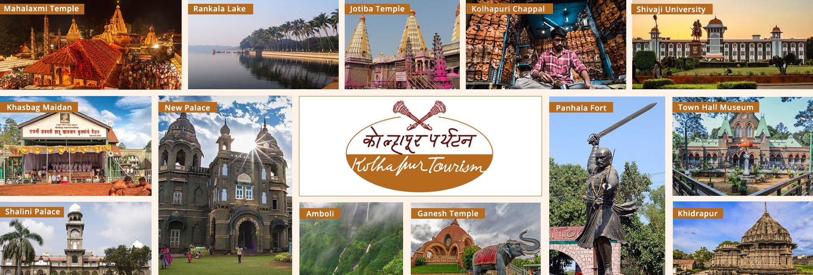
INTRODUCTION
On this website,we will find comprehensive guide to everything Kolhapur has to offer. Whether you are seeking historical marvels authentic cuisine , adventurous escaped or cultural experiences. we have got it all . our site is designed to help you plan your visit explore the city’s hidden treasures and create cherished memories.

Slide 4
PURPOSE
The purpose of EXPLORING KOLHAPUR website –
To serve as a comprehensive online platform that provides visitors
with a range of useful and relevant information about the city of
Kolhapur.
To attract visitors ,provide them with essential information .

Slide 5
OBJECTIVES
The objective of Kolhapur website could be to achieve various goals that contribute to the overall development and promotion of the city.
Showcasing the unique attractions , heritage , cultural , and
Up-to-date information about Kolhapur , including historical
sites , accommodations ,local cuisine, and events.
Providing guidance , maps ,and resources to ensure a seamless and enjoyable travel experience in Kolhapur.

Slide 6
SIGNIFICANCE
Offer real time data access.
Minimize your maintenance cost.
Saves the time and money.

Slide 7
RELEVANCE
Provide valuable information about destination , attractions ,and activities,helping travelers plan their trip.
This website make it easy for people to research and plan their trips from the comfort of their homes.
This websites saves time by offering tools for itinerary planning and Budgeting.

Slide 8
LITERATURE REVIEW
Some existing websites and their limitations:
Kolhapurexplorer –
User experience is low.
Scrolling problem.
Language limited.
Exploreyourcities-
Lack of information about residence or destination.
Insufficient information about places.

Slide 9
METHODOLOGY
Extensive Research: Gather accurate and up-to-date information.
Data collection: Various websites,Social media,Government websites.
Data verification: Survey of tourist guide and residential peoples,Visit to particular tourist place.
Designing Website: Layout should be user friendly and visually appealing.

Slide 10
Tools And Technology Used
TECHNOLOGY | REASON
HTML | HTML is used in the our website to structure and organize the content, making it easy to navigate for visitors. It allows for the inclusion of images, videos, and interactive elements to enhance the user experience. HTML also enables the implementation of forms for gathering feedback and inquiries from users.
CSS | CSS is essential for creating a consistent and appealing design, ensuring a responsive and user-friendly experience for visitors. It allows for customization to reflect the unique identity and branding of Kolhapur.
Javascript | JavaScript is used in the Kolhapur exploring website to add interactive and dynamic elements, such as interactive maps and sliders, to enhance user engagement.

Slide 11
Division Of Work
NAME | WORK RESPONSIBILITY
Arpita Mali | Project Manager,leader
Harshada Patil | Front End Developer
Saniya Sandugade | Front End Developer
Rujuta Naniwadekar | UI/UX Designer

Slide 12
EXPECTED RESULT
The project will promote tourist centric approach to planning and development of tourism.
A tourist-centric approach would ensure the availability of all relevant information and services to tourists online. It will allow feedback and rating of services.
There will be a mechanism for tourists to register their grievances and seek resolution of the same

Slide 13
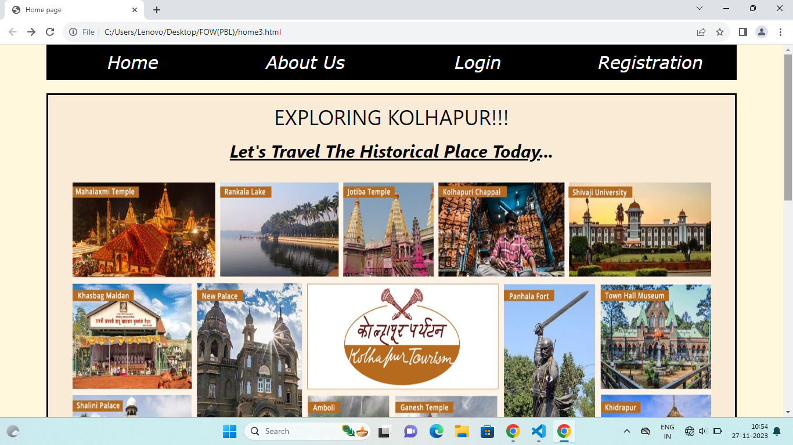
# Screenshots of Website:

Slide 14
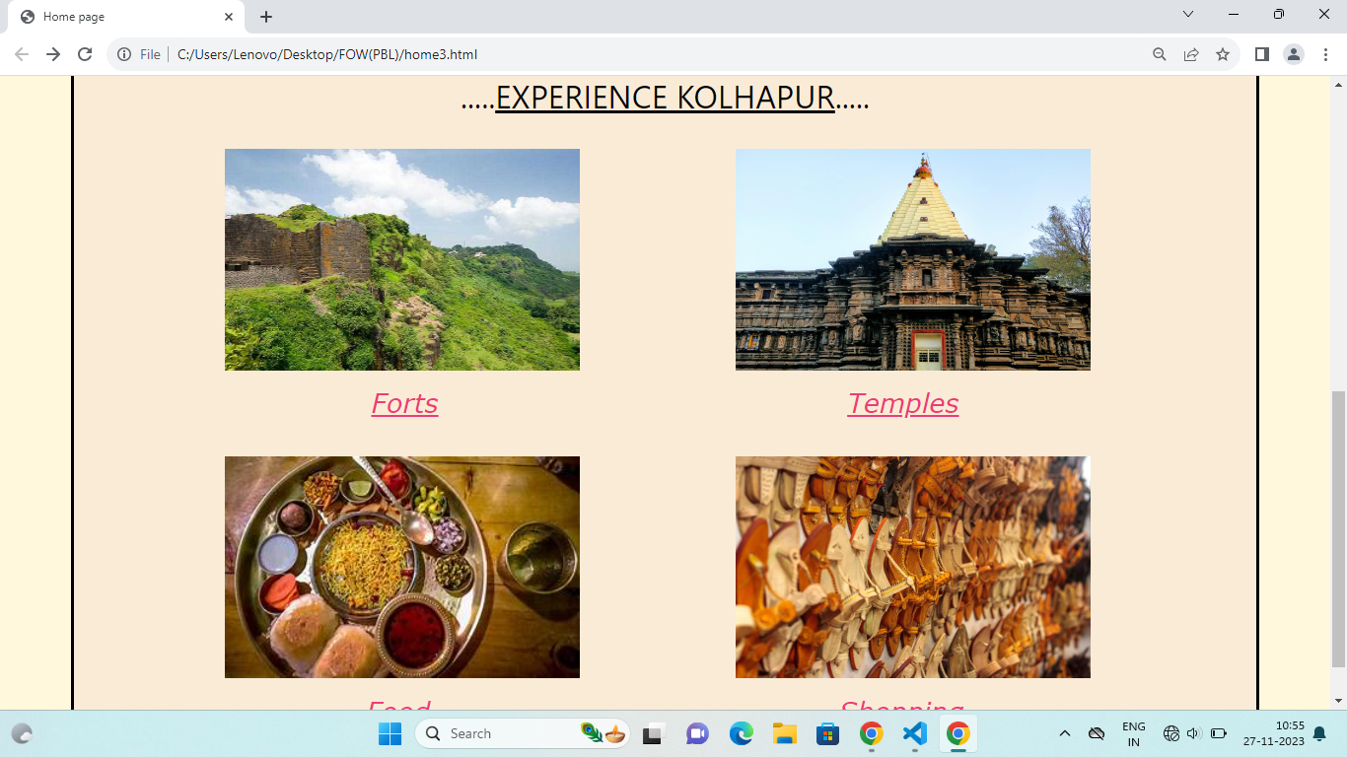

Slide 15
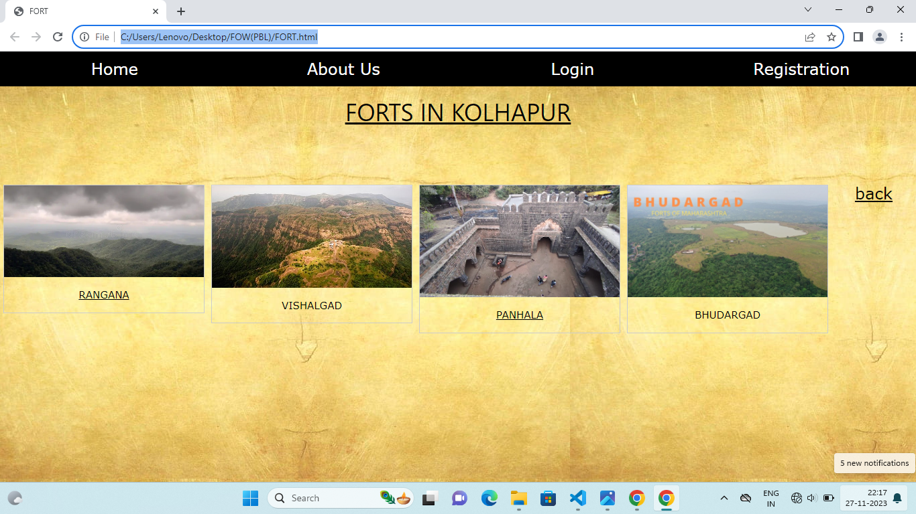

Slide 16
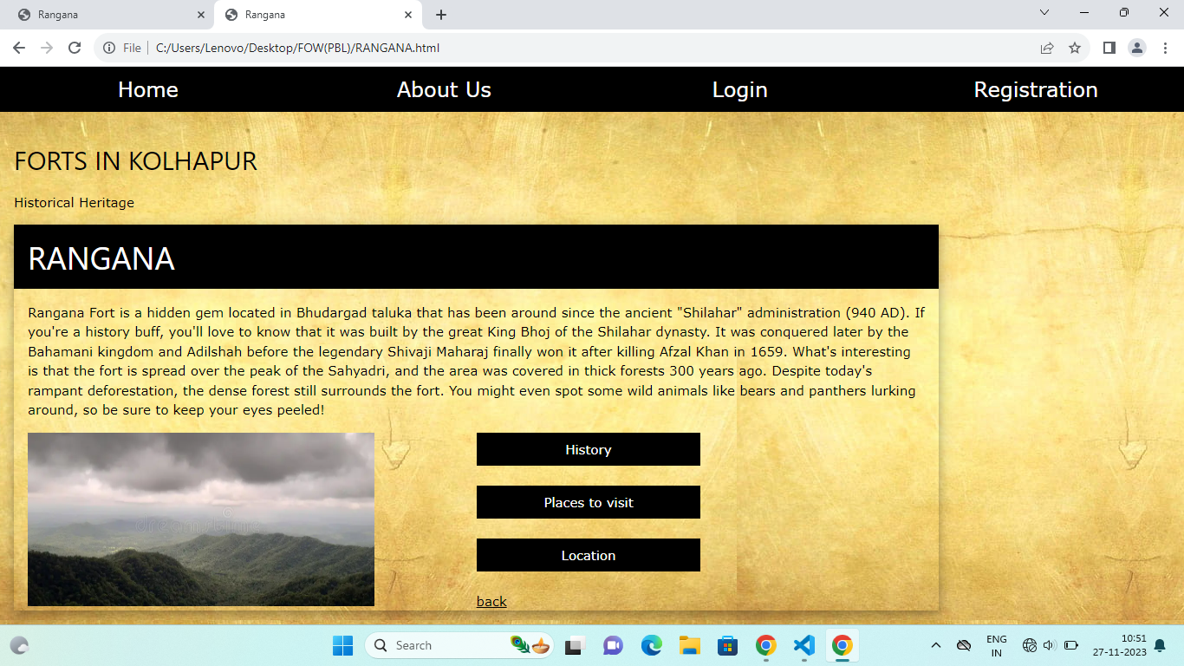

Slide 17
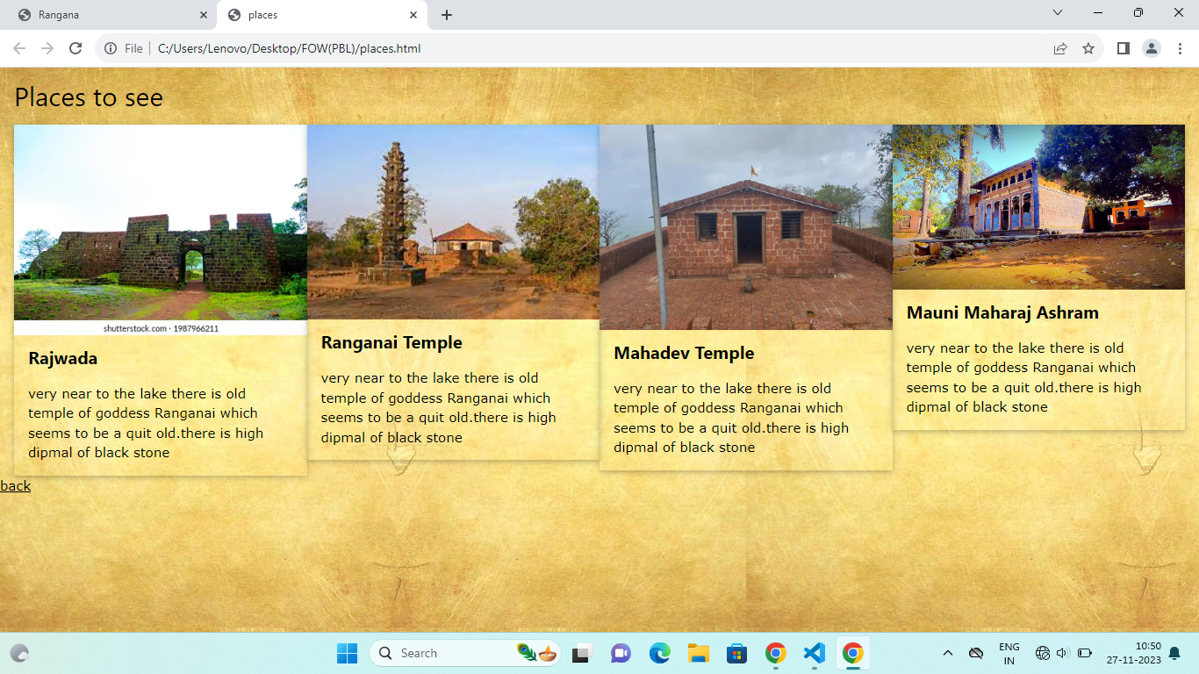

Slide 18
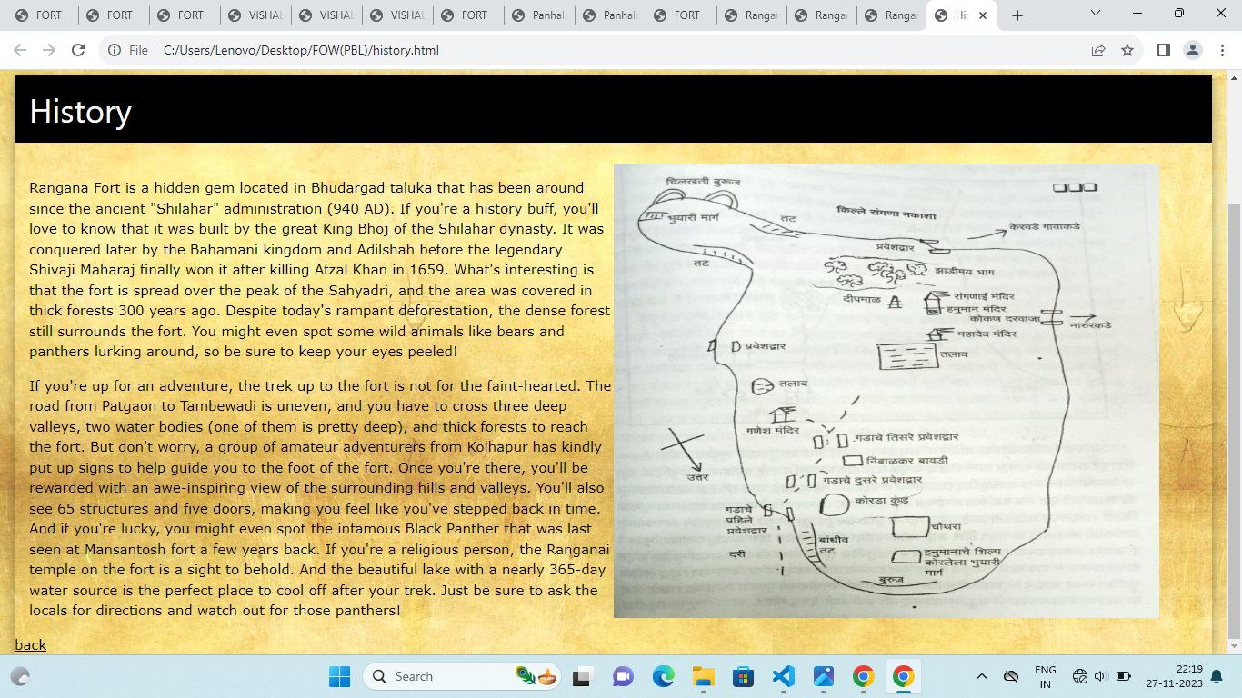

Slide 19
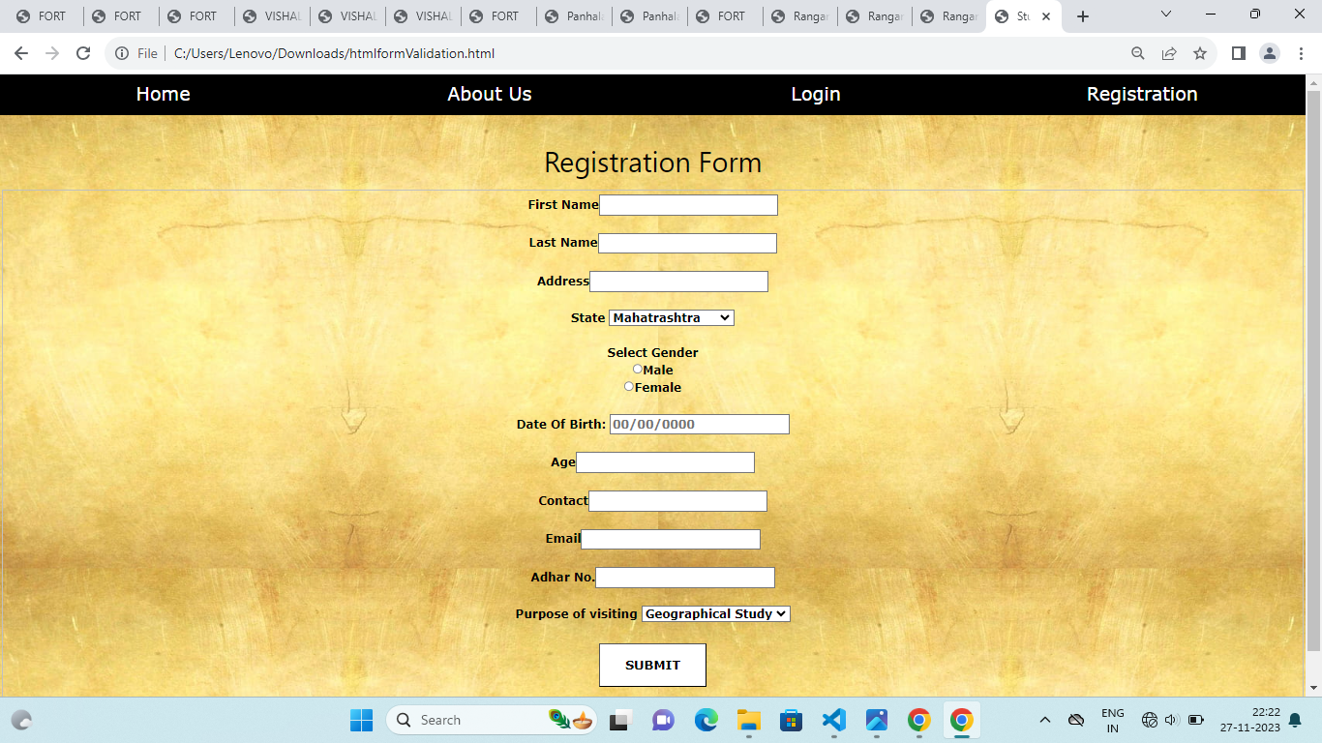

Slide 20
CONCLUSION
Challenges faced:
1. Compatibility: Ensuring that the website works seamlessly across different browsers and devices, considering the varied interpretations of JavaScript code.
2. Performance: Balancing the need for interactive elements with fast loading times to optimize the website's performance.
3. Security: Implementing JavaScript carefully to protect against potential security vulnerabilities, such as cross-site scripting.
4. User experience: Enhancing user engagement with JavaScript while ensuring it doesn't overwhelm or detract from the overall user experience.
Our website’s solution-focused approach has the potential
to revitalize the tourism in Kolhapur. By providing a comprehensive guide, resources, and tools for trip planning,
and promoting responsible tourism practices.our website aims to contribute to the recovery and sustainable development of the
tourism in the long run.

Slide 21
REFERENCES
www.mharastratourism.gov.in
mhexplorer.in
exploreyourcities.com
Kolhapurexplorer.com

Slide 22
THANK YOU

